Slide 1
Evaluating Betweenness Centrality Algorithms On Real World Datasets
By Albert Kutsyy
Supervisor: Dr. Timothy Griffin
Overseers: Prof. Marcelo Fiore, Dr. Robert Mullins

Slide 2
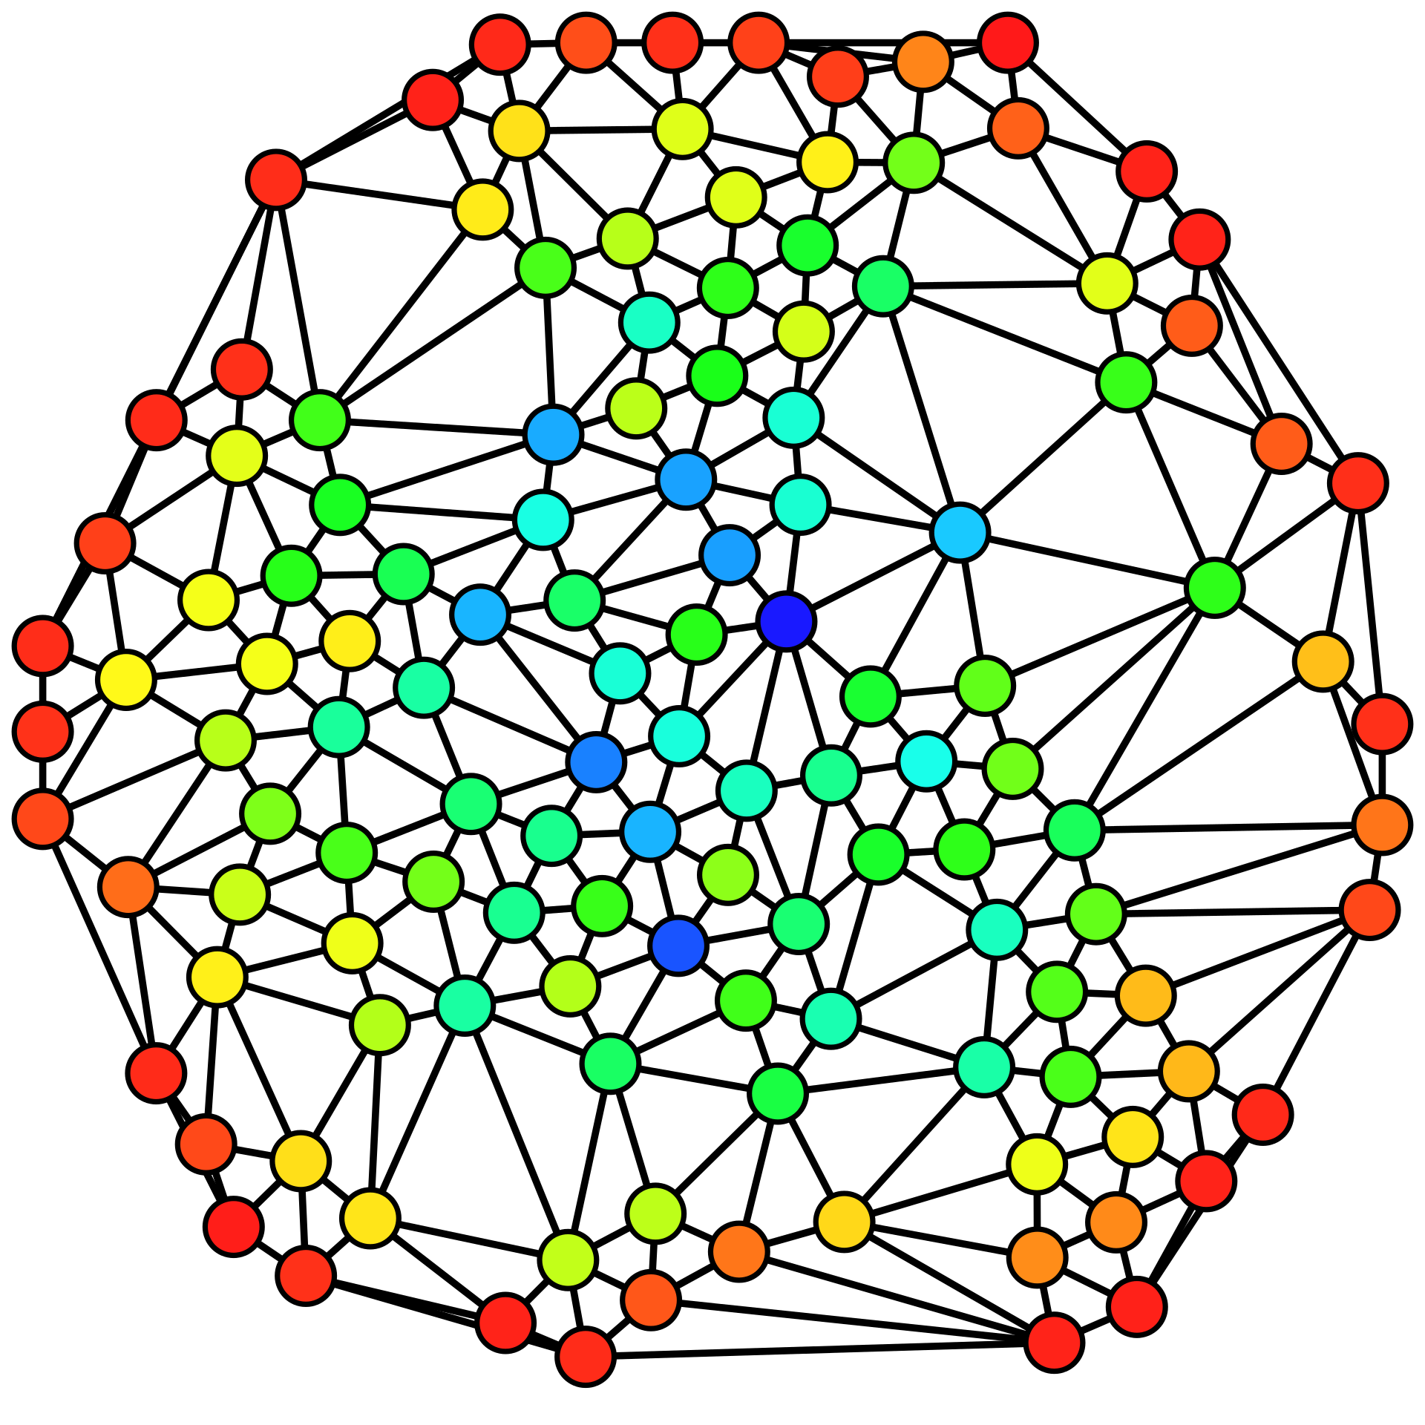
Betweenness Centrality
Image: Claudio Rocchini

Slide 3
Progress
Systems Research Group high-power server
Brandes
Brandes++
METIS
Skeleton construction
Brandes_SK
Centralities

Slide 4
Progress Cont.
Geisberger et al.
Brandes 2008
Linear
Bisection
Bisection Sampling
Bader et al.
KADABRA
Execute experiments

Slide 5
Conclusion
Exactly on track
Unexpected difficulty with Brandes++
KADABRA should be straightforward
Verified correctness, performance
Writing – 3000 words
Extra algorithms

